Slide 1
Final Project of DATA 606
Body Mass Index(BMI) and risk of cardiovascular disease; the Framingham study
Jun Pan

Slide 2
The Framingham Heat Study
Study population: The Framingham Heart Study is a long-term, ongoing cardiovascular cohort study on residents of the city of Framingham, Massachusetts. The study began in 1948 with 5,209 adult subjects from Framingham, and is now on its third generation of participants.
Data collection: The Framingham Heart Study participants, and their children and grandchildren, voluntarily consented to undergo a detailed medical history, physical examination, and medical tests every two years, creating a wealth of data about physical and mental health, especially about cardiovascular disease. All subjects were white.
Type of study: prospective observational longitudinal study.
Data source: www.kaggle.com
Dependent variable: CHD (coronary heart disease)
Independent variable: BMI(body mass index)

Slide 3
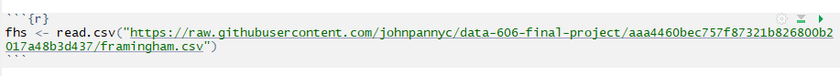
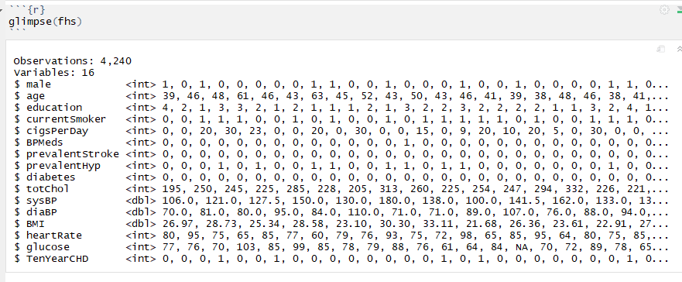
DATA Overview

Slide 4
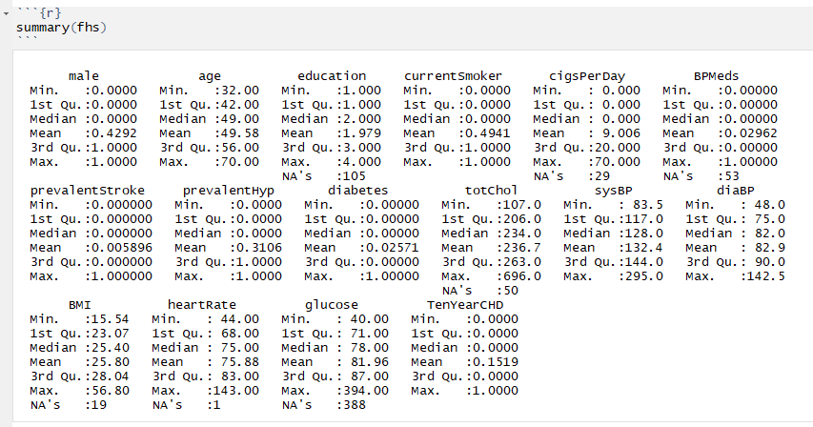

Slide 5
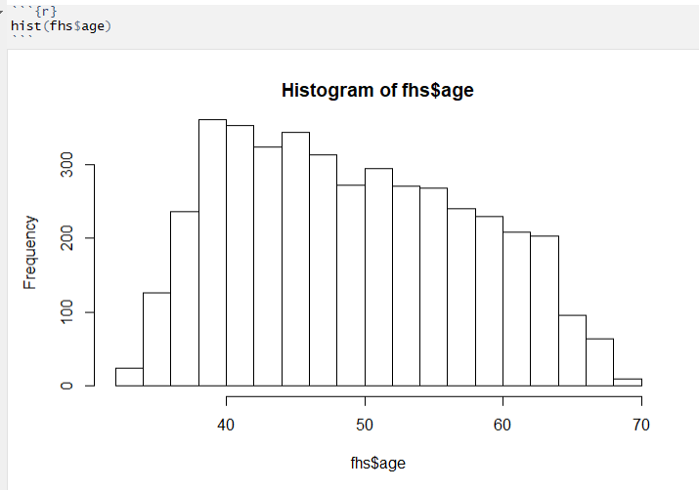
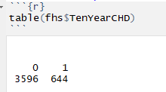
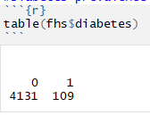
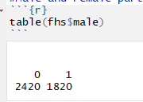
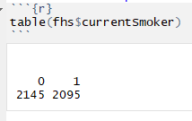
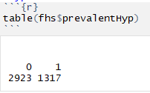

Slide 6
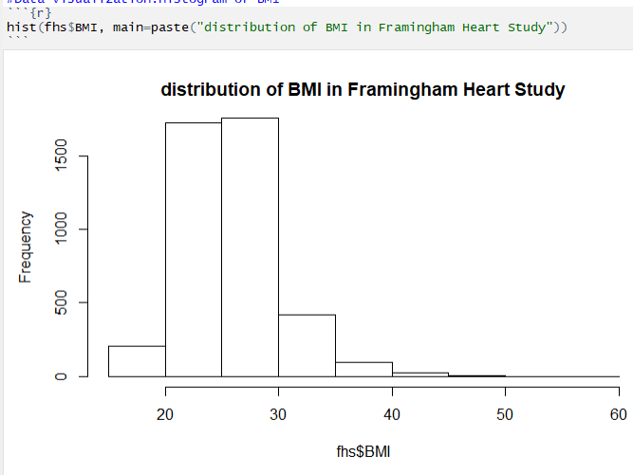

Slide 7
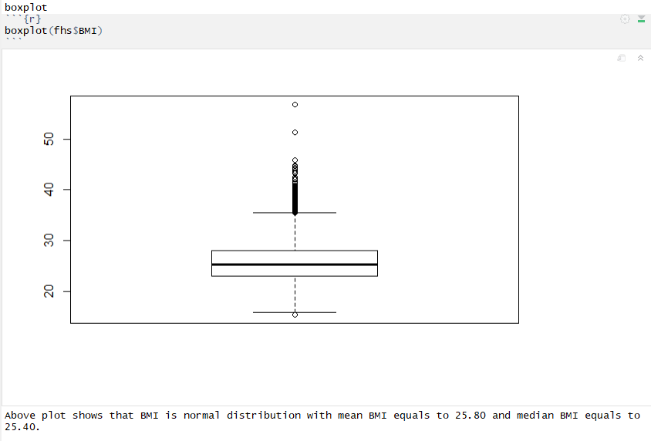

Slide 8
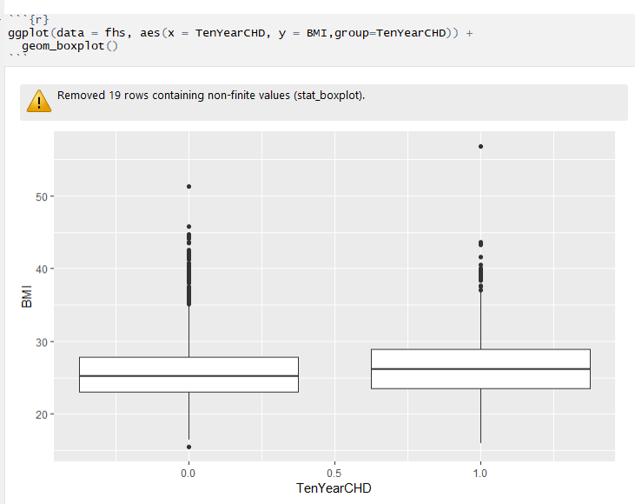
BMI in non-CHD and CHD groups

Slide 9
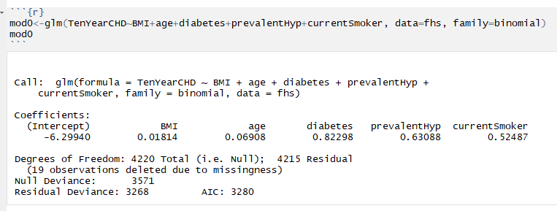
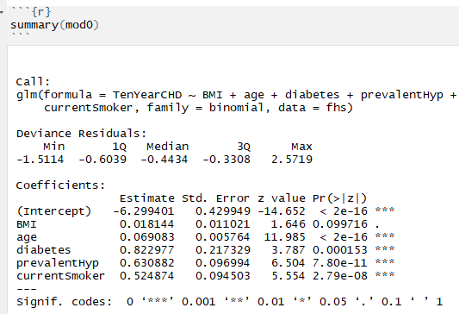
Logistic Regression Model: BMI vs CHD

Slide 10
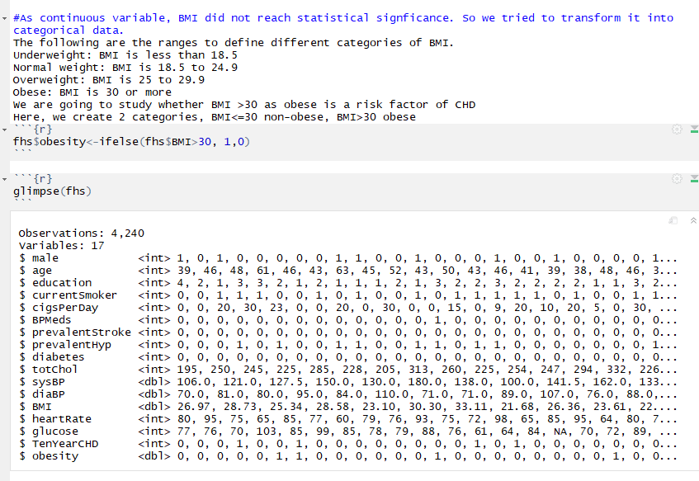
Obese and Non-Obese groups based on BMI

Slide 11
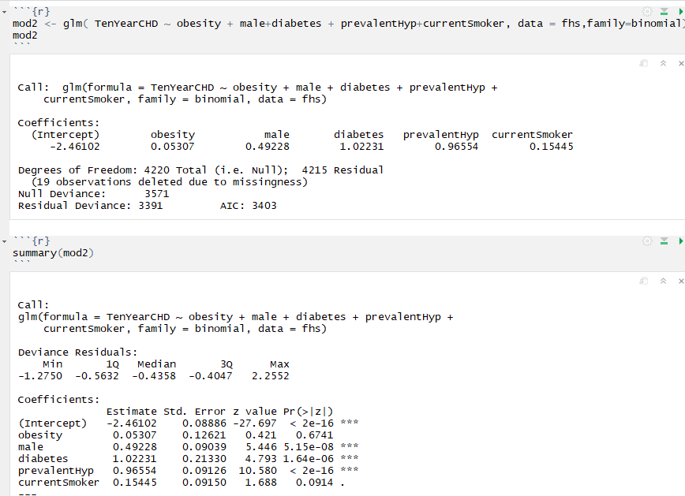
Logistic Regression Model: obese vs CHD
Conclusion: there is evidence of BMI playing a role on CHD in Framingham Heart Study

